Slide 1
CSCI 599 : Content Detection and Analysis for Big Data
Class Presentation : Group Activity Week #1
Aditya Sundaram
Akshay Nataraju
Prince Chopra
Srinidhi Nandakumar

Slide 2
Overview
Real world datasets
Datasets categorized
Are they Big Data or not?
Unintended consequences of each data set

Slide 3


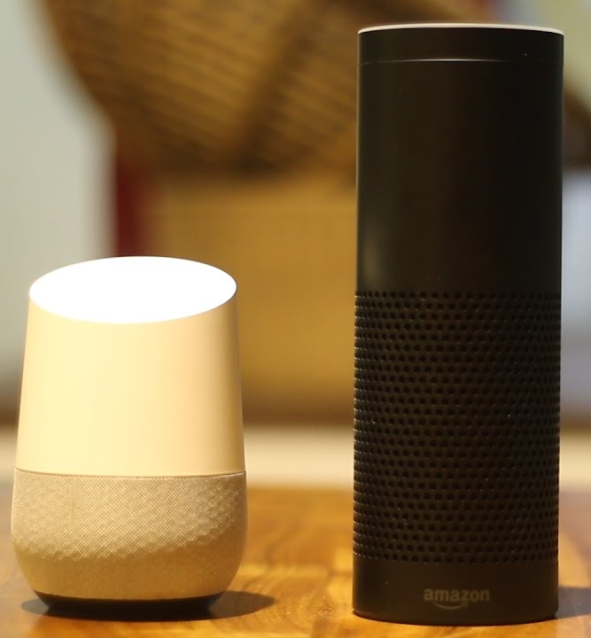
Real world datasets
Subway/Uber/Lyft - Travel Card
Ralphs Card - Shopping Card
Amazon Echo/Google Home - Smart Assistant

Slide 4
Datasets categorized
Datasets \ categories | How are they collected? | What is temporal and spatial coverage? | How are they structured?
Travel Card | Trip info tied to user email/phone User Account Tap card | Travel patterns to and from home and work Travel bias revealed | RDBMS tables
Shopping Card | Shopping membership card | Type of products purchased Frequency Quantity Demand for goods based on location Seasonal food change patterns | RDBMS Graphs & Network flow NoSQL : like the products purchased on a visit.
Smart Assistant | Audio/text queries Google account logged into device Integration with Third Party Applications such as calendar/mail | Interests calendar events. Can know information about schedule, meetings reminders Habits, sleep pattern , work pattern etc | Raw audio data Processed data in blob or nosql store with graph structure linking similar people/queries etc

Slide 5
Are they Big Data or Not?
Volume,Velocity,Value,Veracity,Variety
Main point: They all possess the 5 V’s of Big Data
Travel Card: Huge logistics information
Uber - 40 Million rides/Month
Shopping Card: Large amount of people purchase regularly
30 Million shoppers per day
Smart Assistant: Google, default search engine, huge volume of queries in text/audio

Slide 6
Unintended Consequences
Datasets \ categories | Can they be combined? | What can they be used for?
Travel Card | Can combine travel pattern or precisely geo-behaviour with VISA/Credit Card | Track/locate user Geo based discounts Targeted advertising
Shopping Card | Can combine food habits/ preferences Seasonal changes. Analyse brand preference | Consumer marketing Targeted advertising
Smart Assistant | User account , payment or address information. | Personal information User behavioral habits Record user conversations Breach privacy

Slide 7
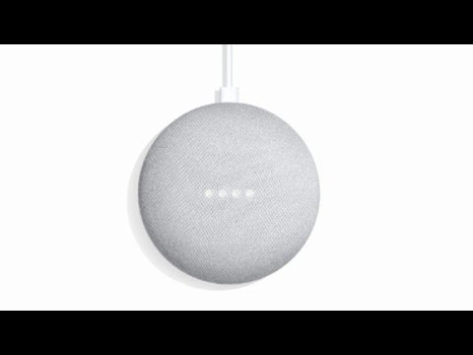
Google mini pre release bug report

